Slide 1
Smart Home Monitoring & Security Robot
Guardian X

Slide 2
Key Components
Main Body
Animated Eye and AQI
Hand (servo motor)
6 Gear Motors (wheels)

Slide 3
Our Project
GuardianX is a smart home monitoring robot that protects your home using real-time sensors, AI control, and remote web access. It detects danger, controls appliances, and keeps your family safe.

Slide 4
Mini Computer (Linux OS)
What it is: A small PC (Raspberry Pi / mini-ITX/mini computer) running Linux (Ubuntu/Mint).
Role: Runs the web dashboard, AI/vision code (OpenCV/Python), hosts camera streaming, and communicates with Arduino over USB or network.
Wiring/Power: 19V → appropriate DC input (or powered by 15V PD charger with regulator). Ensure stable power (3A).
Dev tips: Install Python, Flask or FastAPI, OpenCV, and websocket libraries. Use /dev/video0 or RTSP for camera. Communicate with Arduino over serial (pyserial) or MQTT.
Test: Run a simple Python script to capture camera frames and display them. Test serial send/receive to Arduino.

Slide 5
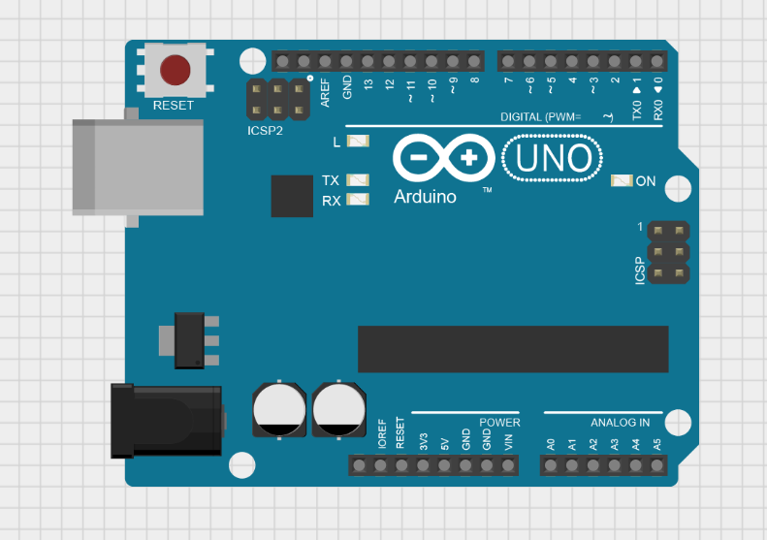
Arduino Uno
What it is: Microcontroller board used for real-time I/O.
Role: Reads sensors (MQ-135, HC-SR04, DHT22), controls motor driver inputs and servos (PWM), sends sensor data to Linux.
Wiring/Power: 5V logic. Power from 5V step-down module if using single battery. Connect Linux via USB (Serial). Use common ground between Arduino and other power supplies.

Slide 6
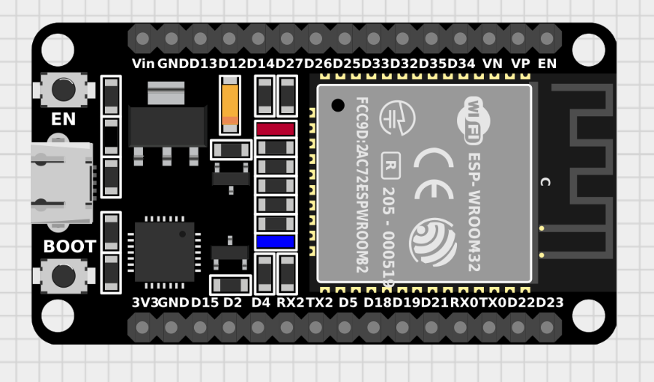
ESP32 (OLED eye)
What it is: Wi-Fi microcontroller with built-in BLE, many I/O, and SPI/I2C support.
Role: Drives OLED displays (eyes), handles small UI/notifications, and can act as a Wi-Fi peripheral for quick status pages. Wiring/Power: 3.3V supply. Connect OLED via I2C (SDA, SCL). Ensure level compatibility. Dev tips: Use Arduino core or ESP-IDF. Use SSD1306 or Adafruit_SSD1306 libraries. Keep animations lightweight. Test: Display simple text and emoji-like faces on OLED. Toggle expressions from serial or via HTTP.

Slide 7
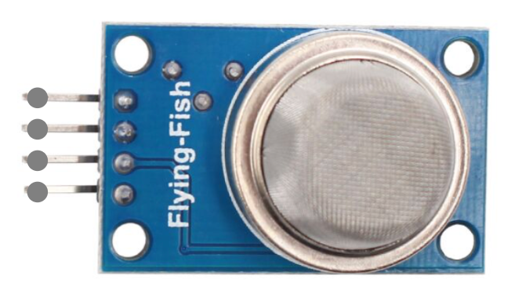
MQ-135 (Air Quality)
What it is: Gas sensor for detecting air pollutants / general air quality. Role: Detects smoke/air quality changes to trigger alerts. Wiring/Power: Analog output to Arduino A0. Needs heater preheating (~24–48 hrs when new) and stable supply (5V). Dev tips: Calibrate baseline in fresh air; use moving average and thresholds. Don’t rely on absolute ppm values—use relative change/trend. Test: Measure baseline; exhale near sensor to see value spike; set threshold to trigger alert.

Slide 8
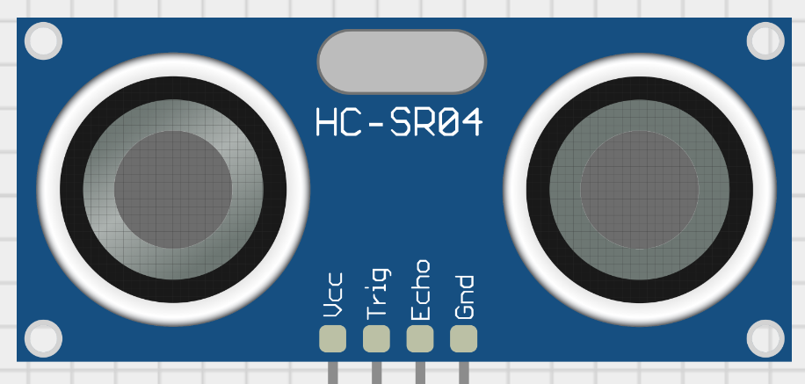
Ultrasonic Sensor (HC-SR04)
What it is: Distance sensor using ultrasonic pulses. Role: Detects obstacles, intrusions, and proximity to trigger movement or alerts. Wiring/Power: Vcc 5V, GND, TRIG and ECHO to Arduino digital pins (use resistor divider for Echo if needed). Dev tips: Use timer-based measurement; ignore readings <2cm or >400cm; average multiple readings to reduce noise. Test: Run distance scan and display on serial; verify readings change when moving object.

Slide 9
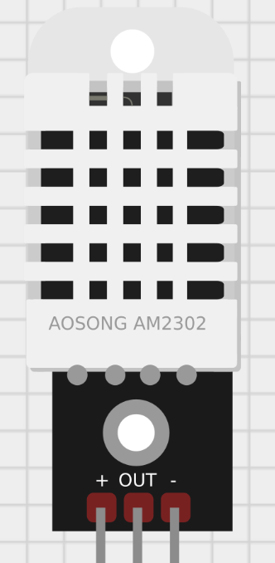
DHT22 (Temperature & Humidity)
What it is: Digital temperature and humidity sensor.
Role: Monitors environment for overheating or unusual humidity (fire or leak indicators). Wiring/Power: Single-wire data to Arduino digital pin + 5V/GND (+ pull-up resistor ~4.7K). Dev tips: Use a stable library (e.g., DHT sensor library). Readings should be polled every 2–5 seconds (not too often). Test: Print temp and humidity on Serial; warm or cool the sensor to confirm changes.

Slide 10
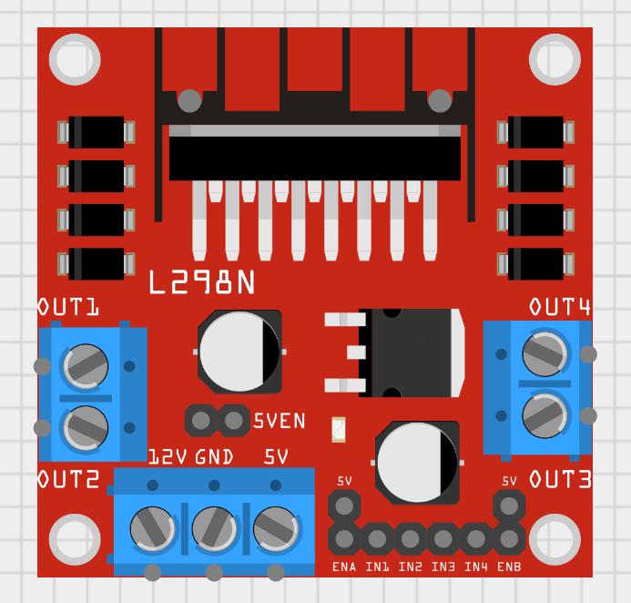
Motor Driver (L298N / L293D)
What it is: H-bridge driver to control DC motors direction and speed.
Role: Drives the 6 DC motors for movement. Wiring/Power: Motor supply (12V) to driver Vmotor, driver logic to 5V. Connect Arduino PWM outputs to EN pins and digital pins to IN1–IN4. Use flyback diodes and proper current rating. Dev tips: L298N is bulky and dissipates heat—use heatsink. Consider modern MOSFET drivers or motor controllers for efficiency. Test: Send PWM and direction commands; verify motors turn correctly and stop on command.

Slide 11
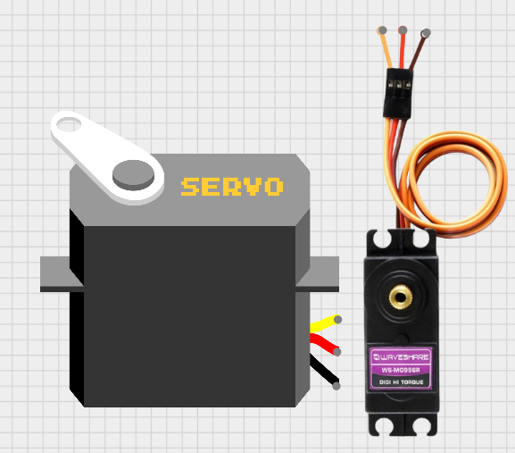
Servos (Tower Pro mini x4, Metal Gear x1)
What it is: Distance sensor using ultrasonic pulses. Role: Detects obstacles, intrusions, and proximity to trigger movement or alerts. Wiring/Power: Vcc 5V, GND, TRIG and ECHO to Arduino digital pins (use resistor divider for Echo if needed). Dev tips: Use timer-based measurement; ignore readings <2cm or >400cm; average multiple readings to reduce noise. Test: Run distance scan and display on serial; verify readings change when moving object.

Slide 12
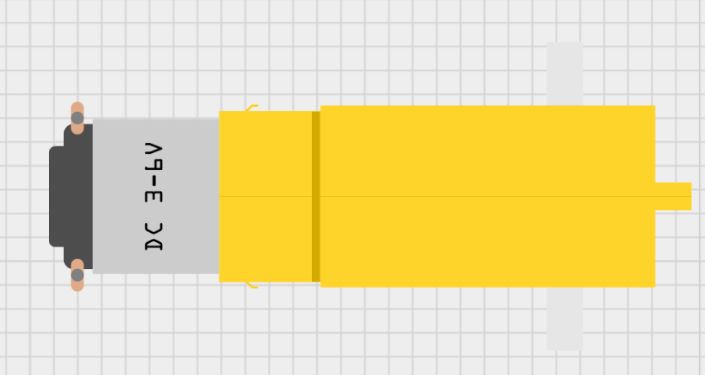
DC Motors & Wheels (x6)
What it is: Drive motors and wheels for movement.
Role: Locomotion — move robot forward/back/turn. Wiring/Power: Connect motors to motor driver outputs. Use 12V supply for motors if required. Ensure current rating and use MCB/fuse protection. Dev tips: Implement speed ramping to avoid stalls. Use encoders if you need precise distance control. Test: Move forward/backward and turn; test on intended floor surface.

Slide 13
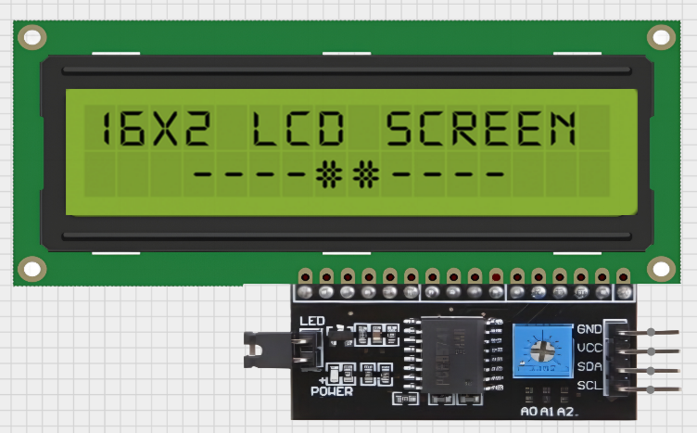
Displays (LCD I²C, OLED x2)
What it is: User information displays. LCD I²C for text; OLED for expressive eyes.
Role: Show system status, alerts, IP address, battery level, emotional expressions. Wiring/Power: I2C SDA/SCL to Arduino/ESP32. Use pull-ups if necessary. 5V for LCD module, OLED often 3.3–5V depending on module. Dev tips: Use I²C address scanner if display isn’t found. Keep UI minimal and legible. Test: Print IP, status lines, and change OLED face with events.

Slide 14
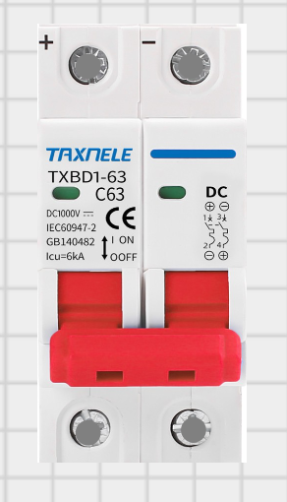
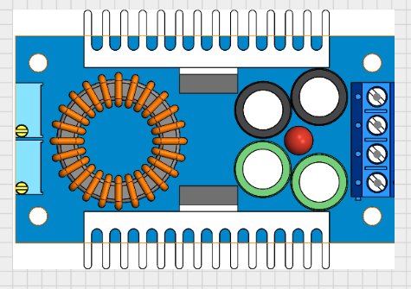
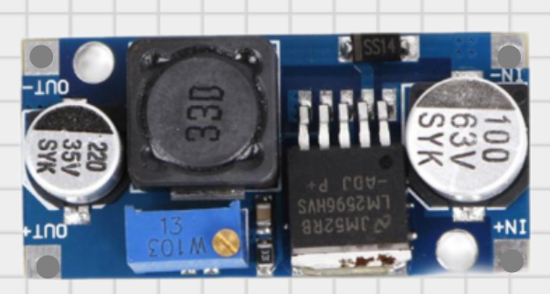
Power System (19V 3A, Step Up/Down modules, MCB)
01
02
03
MCB
Step UP Module
Step Down Module

Slide 15
Wi-Fi Router & Local Area Network
What it is: Network infrastructure.
Role: Connects user devices to Linux server and allows remote control/monitoring.
Setup tips: Use static IP for mini computer or mDNS. Secure network with password and firewall rules.
Test: Access the web dashboard from a phone on the same network; test remote access (port forwarding or secure VPN).

Slide 16
Camera (USB Webcam / IP Camera)
What it is: Visual sensor for live feed and computer vision.
Role: Provides video for streaming, motion detection, and AI models.
Wiring/Power: USB to mini computer or IP camera to LAN. Ensure camera driver support on Linux.
Dev tips: Use OpenCV for capture and streaming (MJPEG or RTSP). Keep frame rate sensible (10–15 FPS) for bandwidth. Use threaded capture.
Test: Stream video to browser; measure latency and CPU load.

Slide 17
Software Stack (HTML/CSS/JS, Python)
What it is: Frontend web interface + backend server and control logic.
Role: Web dashboard UI (control, live camera), backend (Flask/FastAPI), serial bridge to Arduino, AI/processing on mini computer. Dev tips:
Frontend: simple control buttons, status panel, live video element.
Backend: REST or websocket for real-time control.
Serial protocol: simple JSON lines or custom CSV to reduce parsing complexity.
Test: Open dashboard, send movement commands, verify robot responds. Monitor logs.

Slide 18
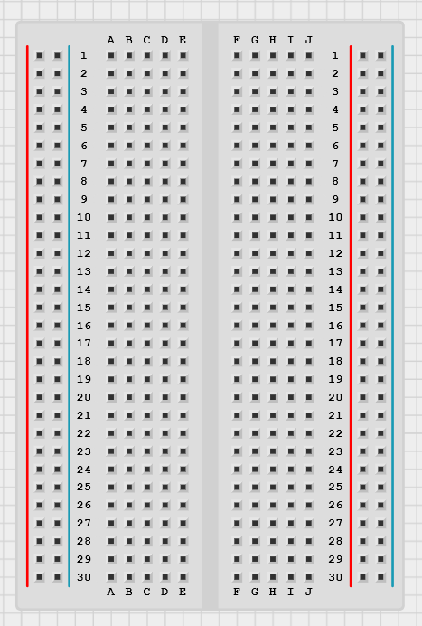
Breadboards & Prototyping
What it is: Temporary wiring boards. Role: Prototype circuits, test sensor wiring before final soldering. Tips: Use for early testing only; move to soldered/perfboard for final build. Keep wires short and labeled. Test: Verify each sensor/module works before integrating into robot frame.

Slide 19
Robot can be accessed from anywhere
Offline
Local Range Up to 100 ft.
Online
From anyware in the world !

Slide 20
Thank you!
Made By : Avinash

